Slide 1

Data Engineering
Project Milestone | and ||
Job Posting Dataset EDA , Data Cleaning and Airflow.
PRESENTED BY: Walid Hebat Omar Farid Mostafa Lamloum Karim Hesham | DATE: 31-01-2024

Slide 2

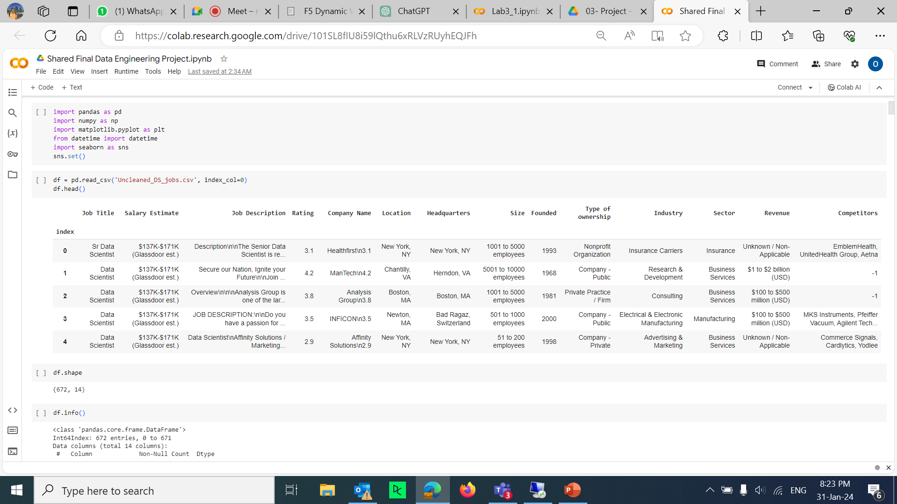
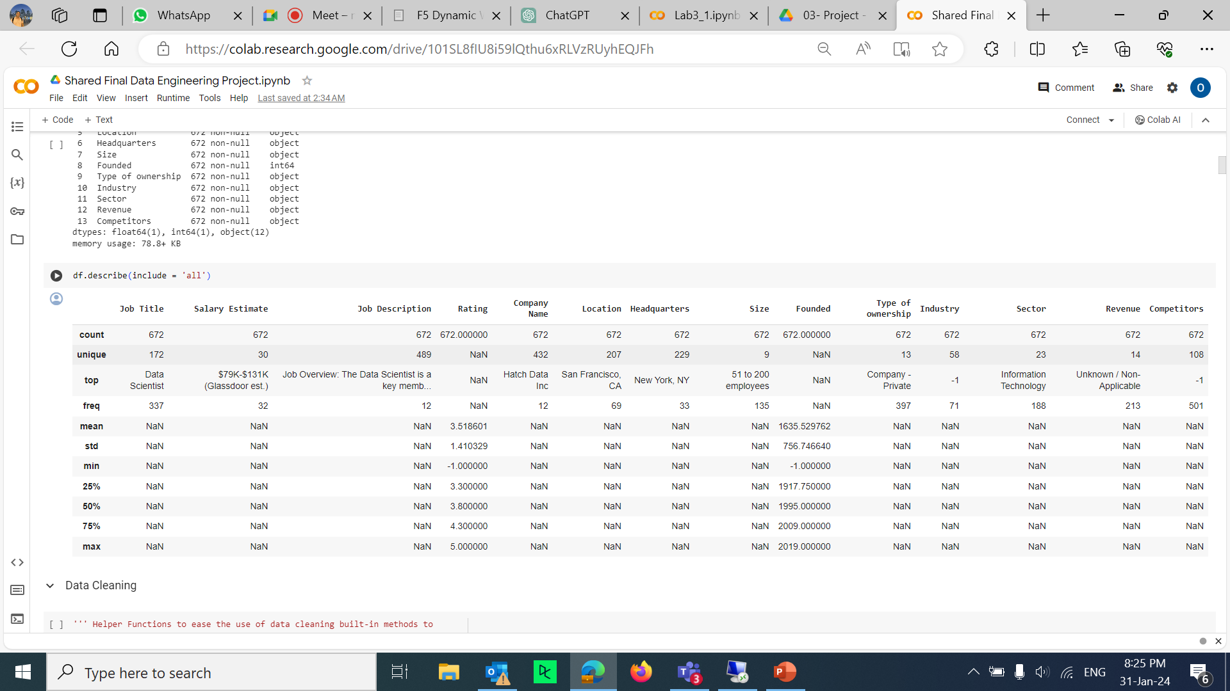
Raw Data
PROJECT PLAN

Slide 3

Data Cleaning
Column Name
Job Title
Salary Estimate | Removing any text and special characters in the salary estimate field Divided it to min and max salary
Job Description | Removing unnecessary wordings in Job description
Rating
Company Name | Cleaning company name from \n and rating
Location
Headquarters
Size | Removed “Employees” Replaced the (-1) and (to)
Founded
Type of ownership | Removed “Company – “ Replaced the (-1)
Industry | Replaced the (-1)
Sector | Replaced the (-1)
Revenue | Removed the currencies Signs
Competitors | Replaced the (-1)

Slide 4
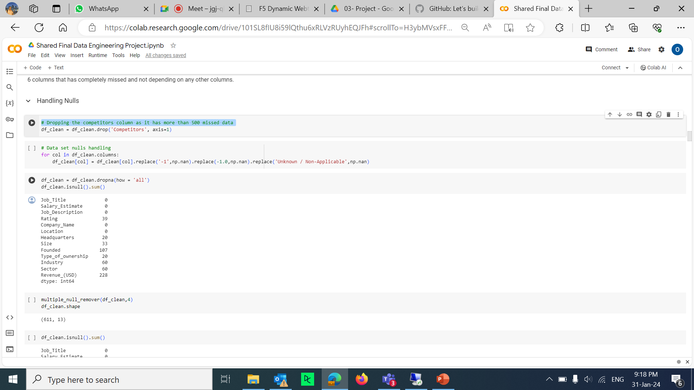
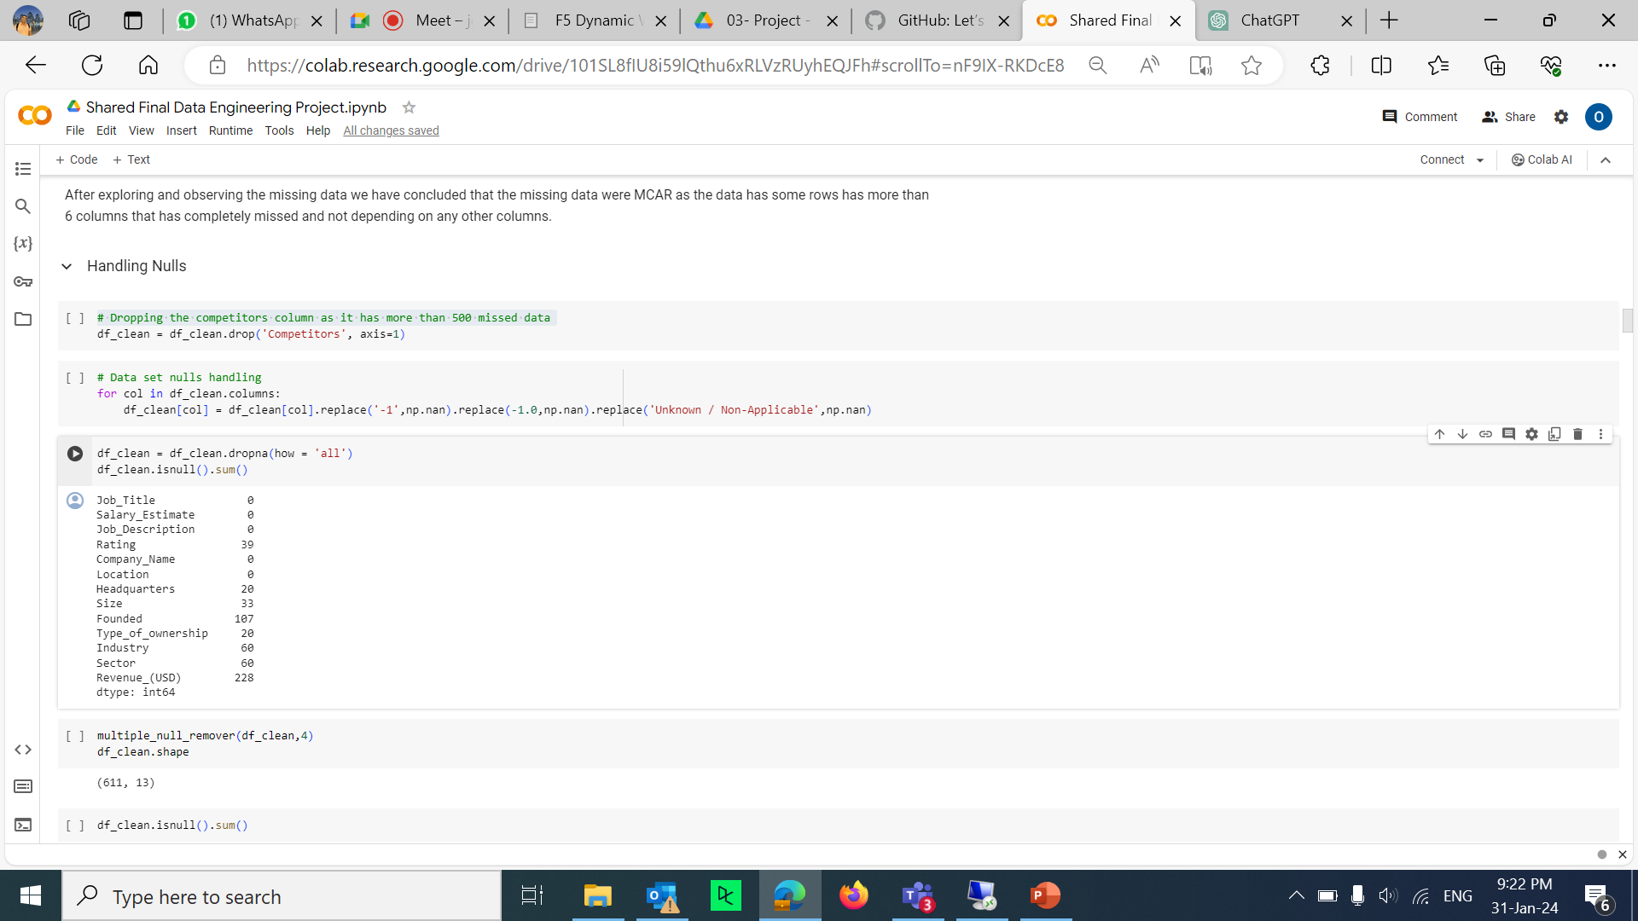
Handling Nulls and Outliers
PROJECT PLAN
-Dropping the competitors column as it has more than 500 missed data

Slide 5
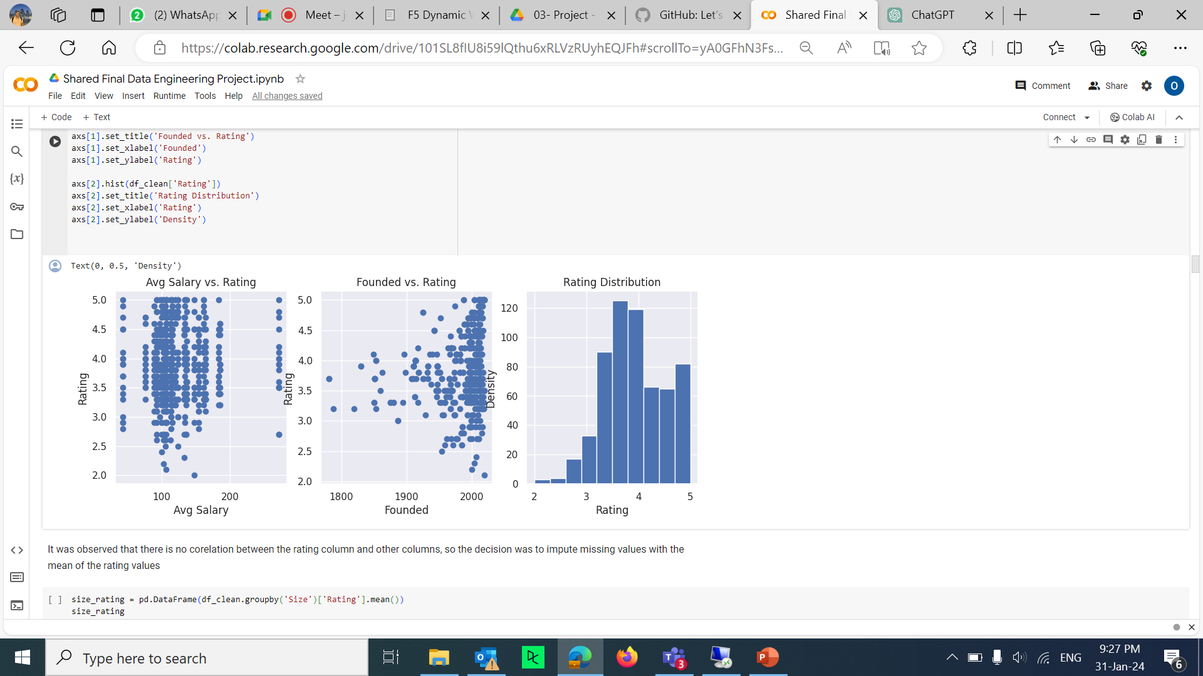
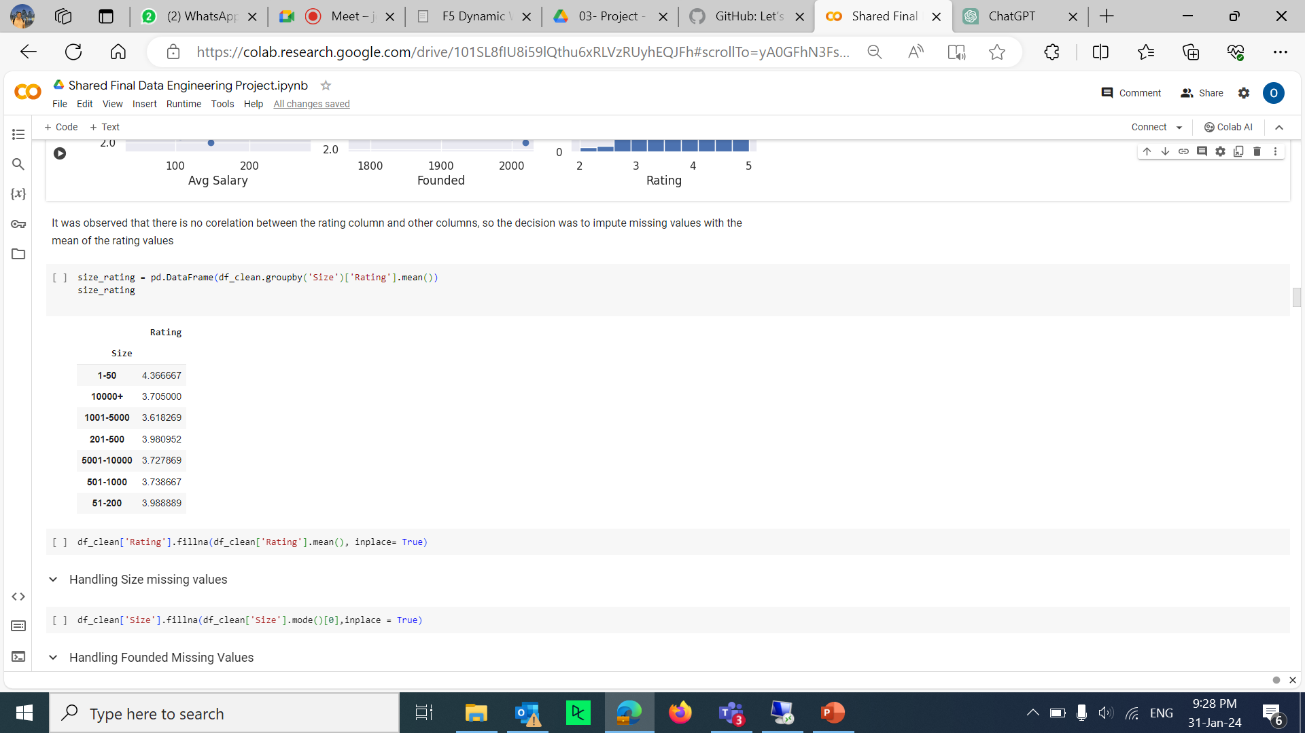
Handling Nulls and Outliers
PROJECT PLAN
For the rating analyzed relationships of rating with different columns to find the most suitable way to impute the missing values

Slide 6
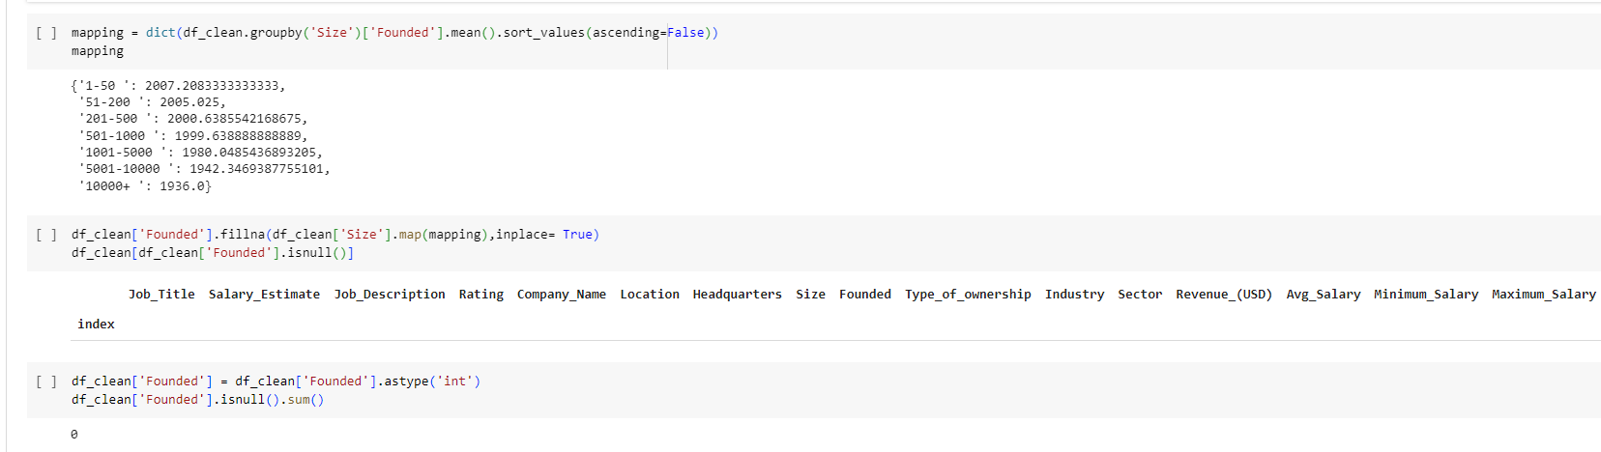
Handling Nulls and Outliers
PROJECT PLAN
For the Company size We Created a mapping that relates the company's size to the average founded year in order to impute the missing Founded values with the suitable values of founded years

Slide 7
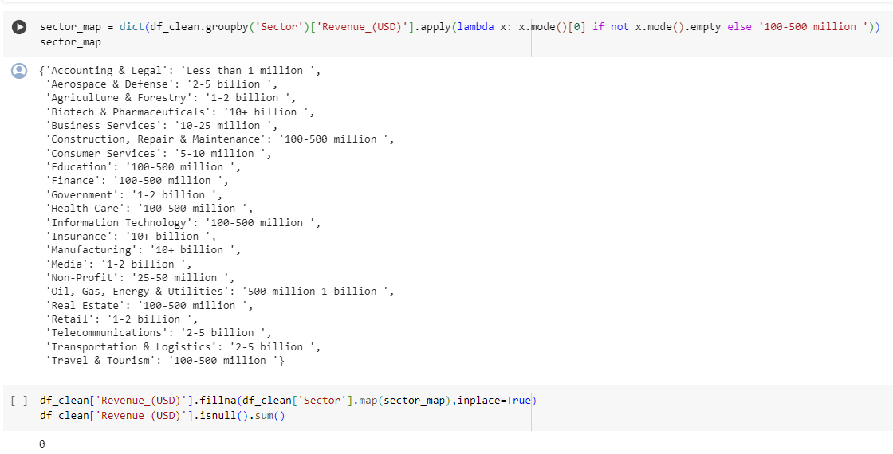
Handling Nulls and Outliers
PROJECT PLAN
For the Revenue Missing data We created a mapping for the Sector and the most common revenue rearranged in order
to impute the revenue ranges using the suitable value

Slide 8
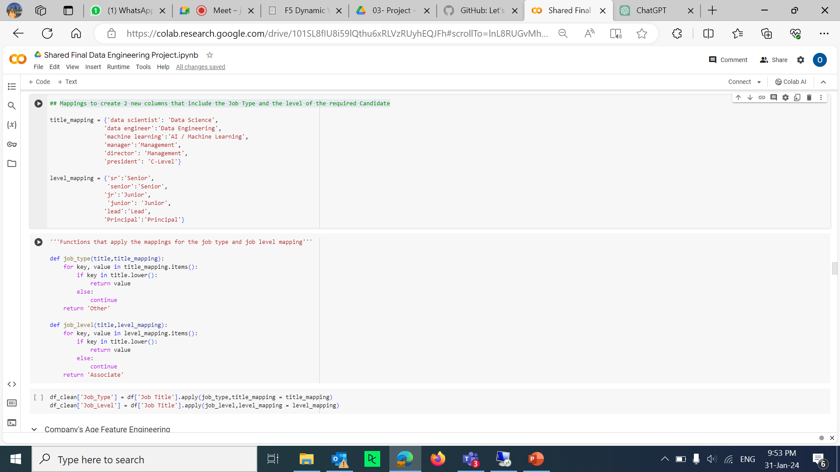
Feature Engineering
Mappings to create 2 new columns that include the Job Type and the level of the required Candidate

Slide 9
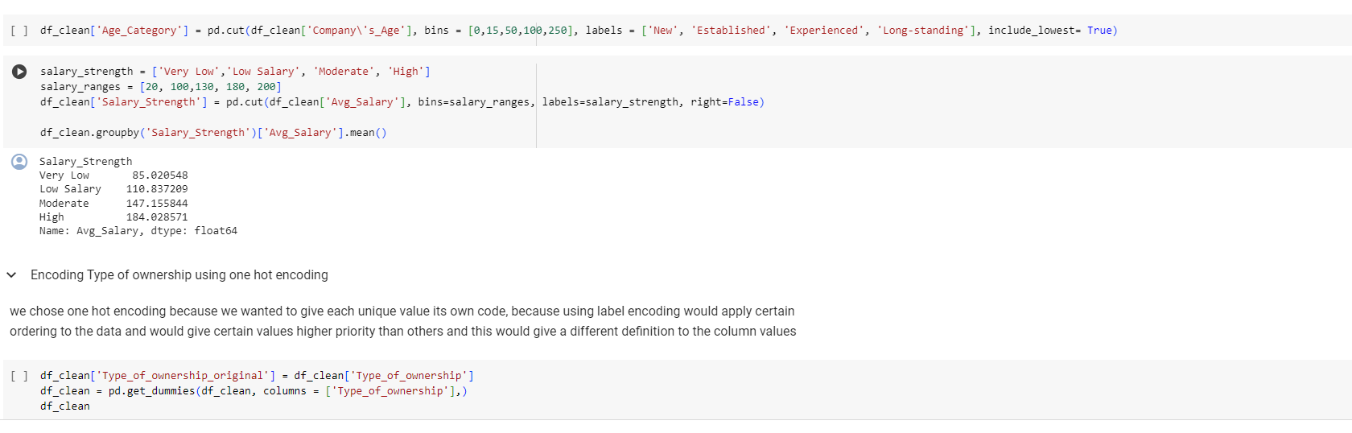
Data Discretization and Encoding
PROJECT PLAN
Discretized Salary’s data into 4 (Very Low, Low salary, Moderate , High)

Slide 10
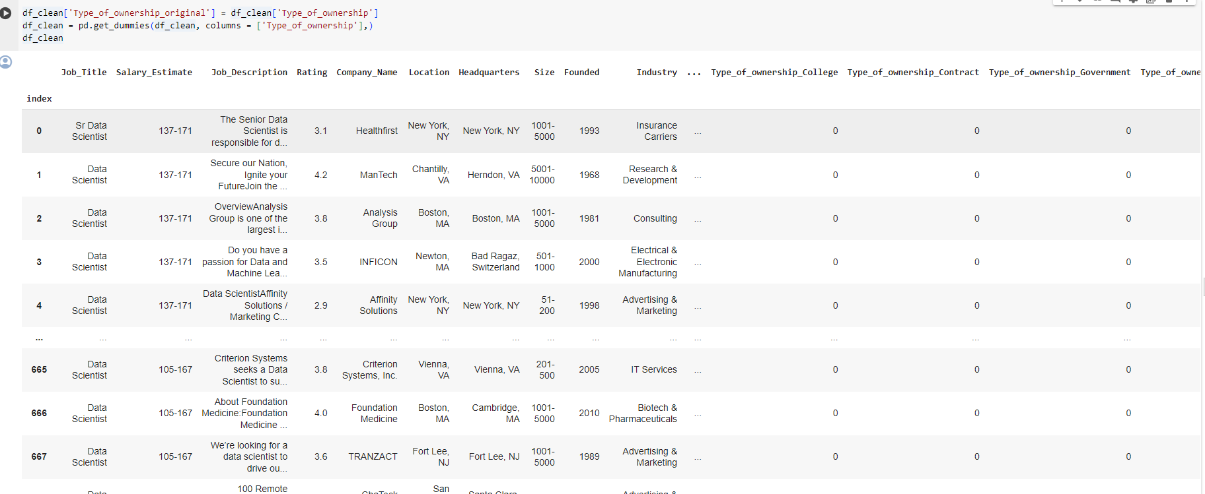
Data Discretization and Encoding
PROJECT PLAN
we chose one hot encoding because we wanted to give each unique value its own code, because using label encoding would apply certain ordering to the data and would give certain values higher priority than others and this would give a different definition to the column values

Slide 11
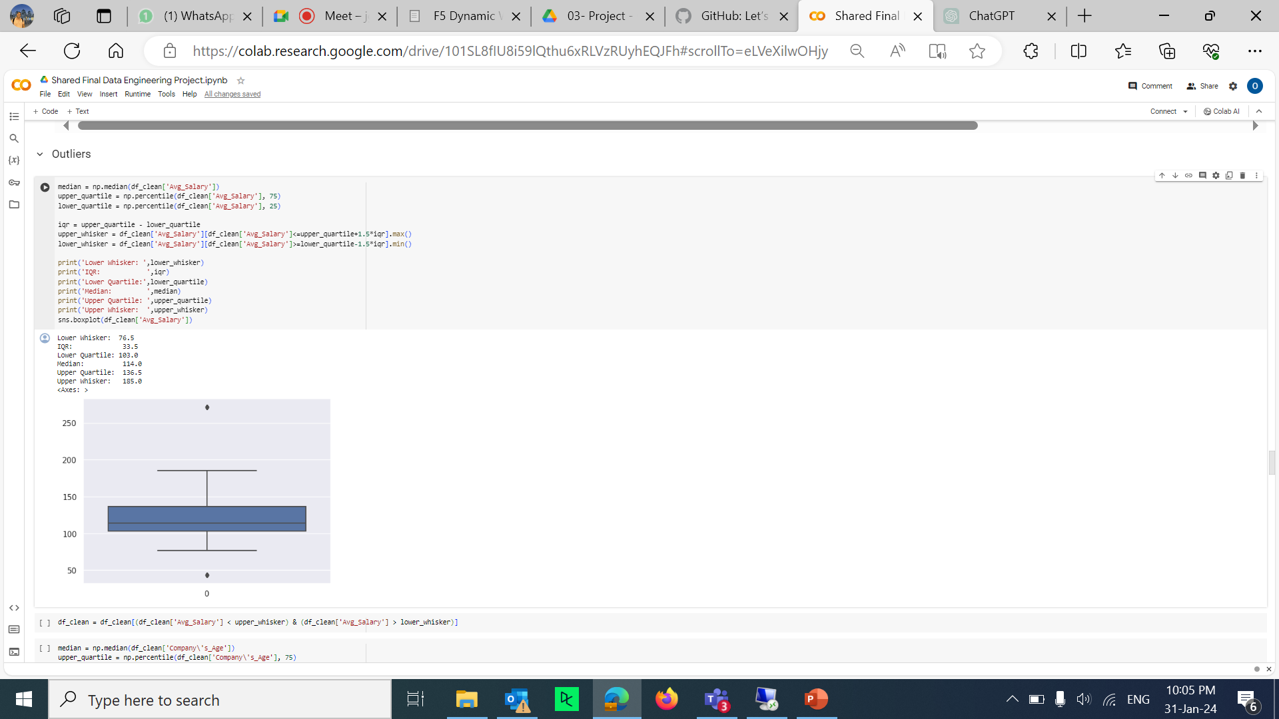
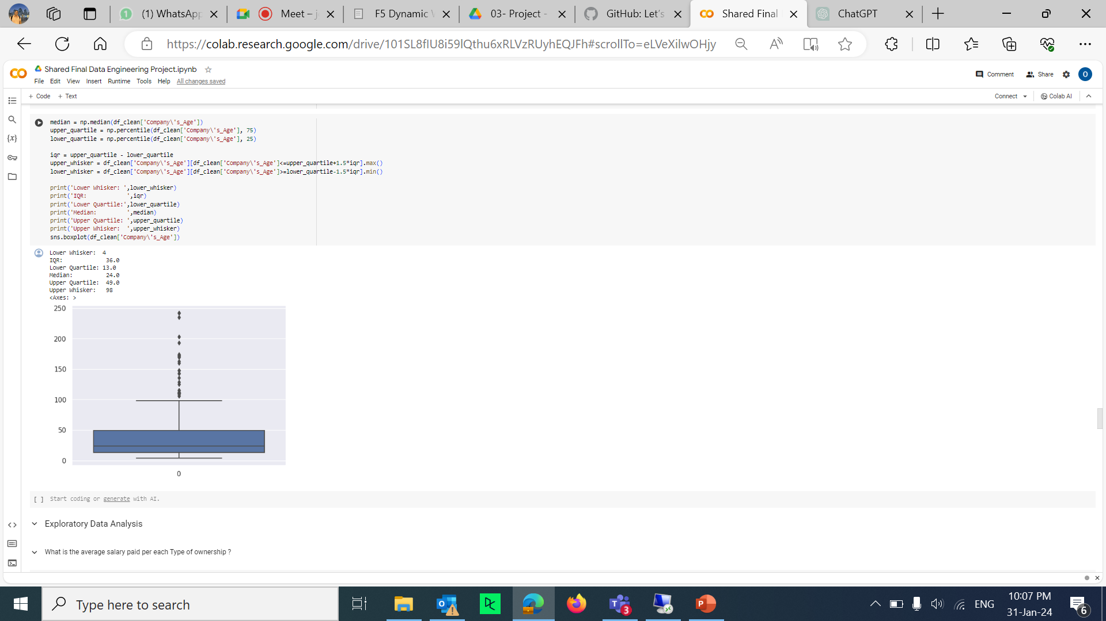
Handling Outliers
For the avg salary
For the Company’s Age

Slide 12
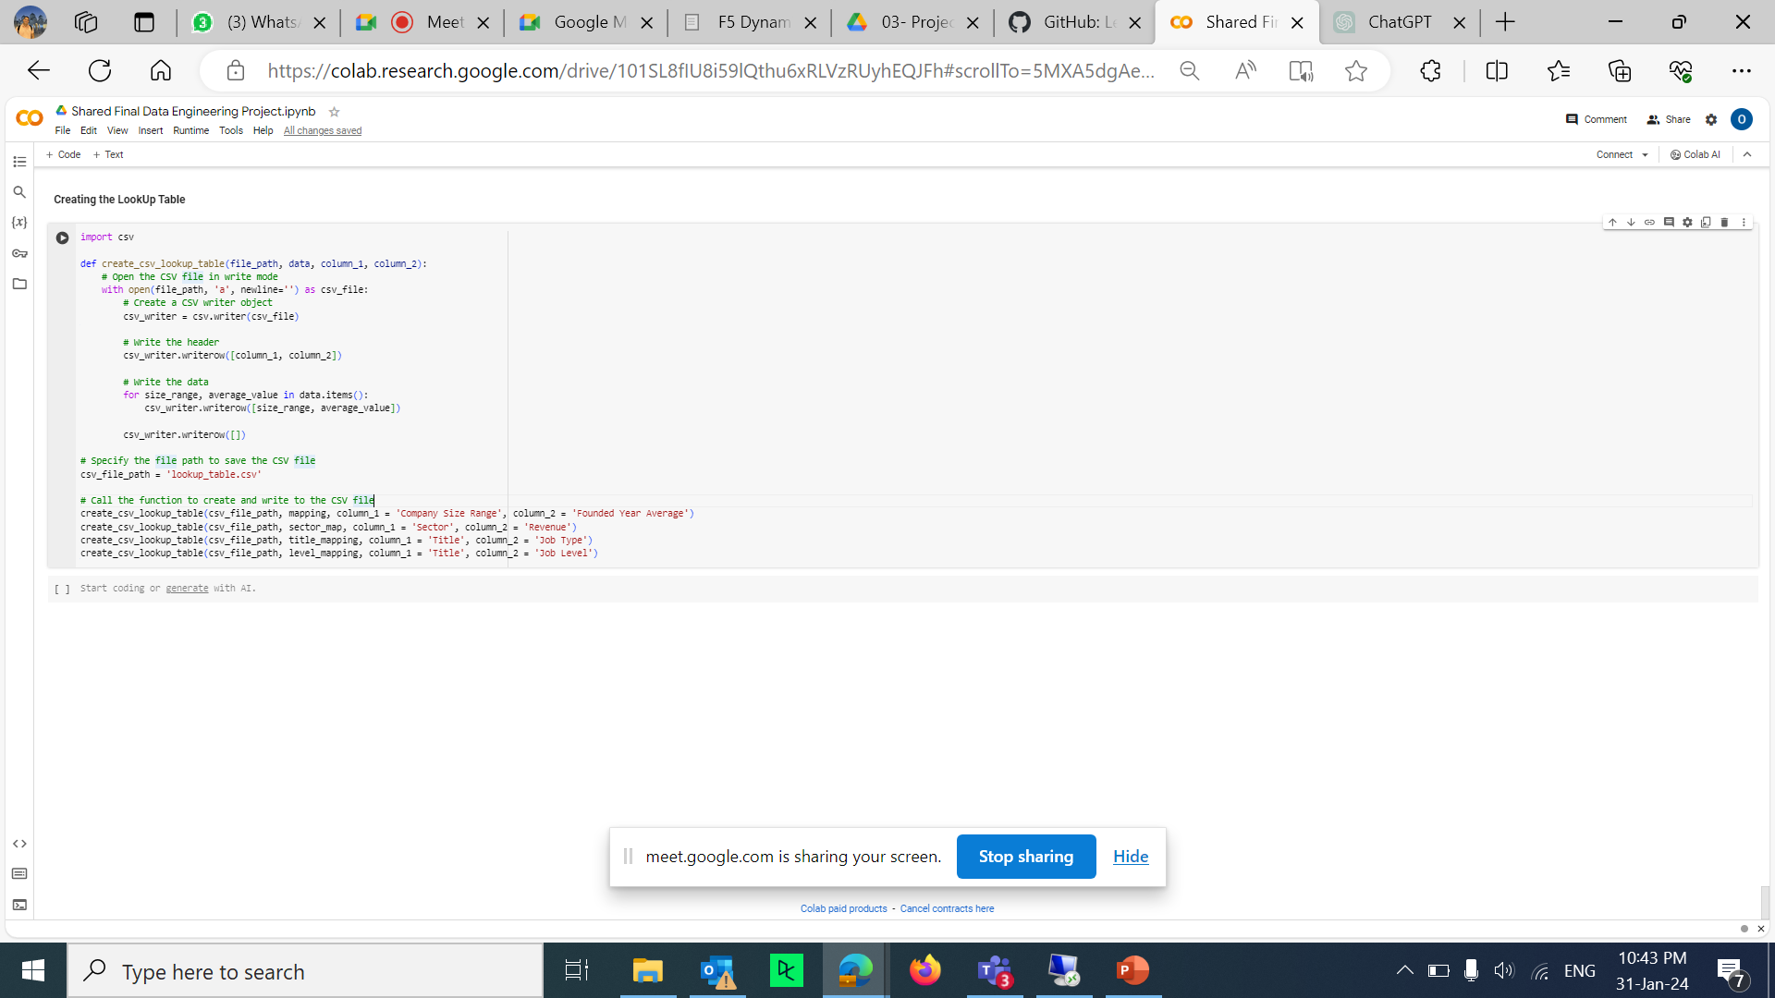
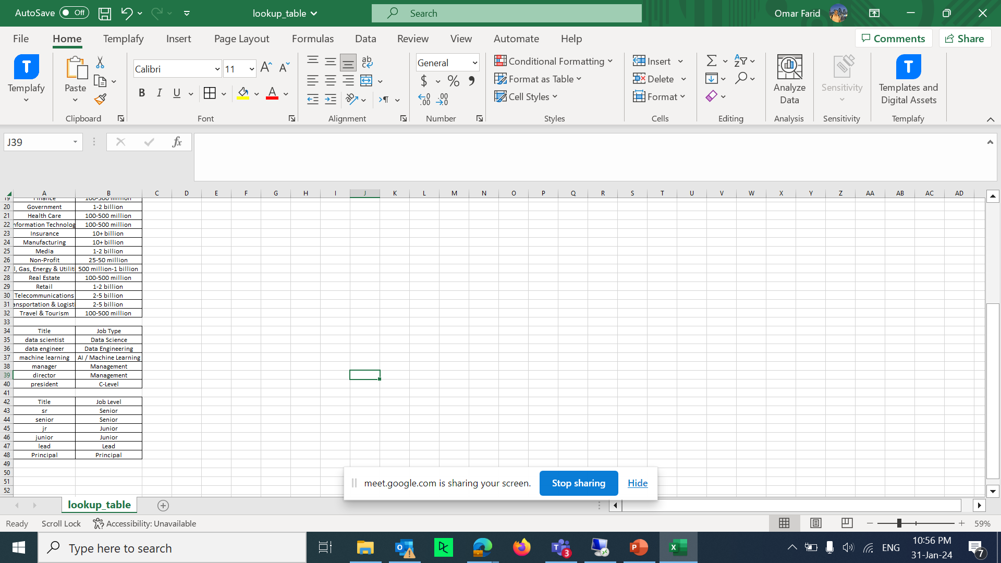
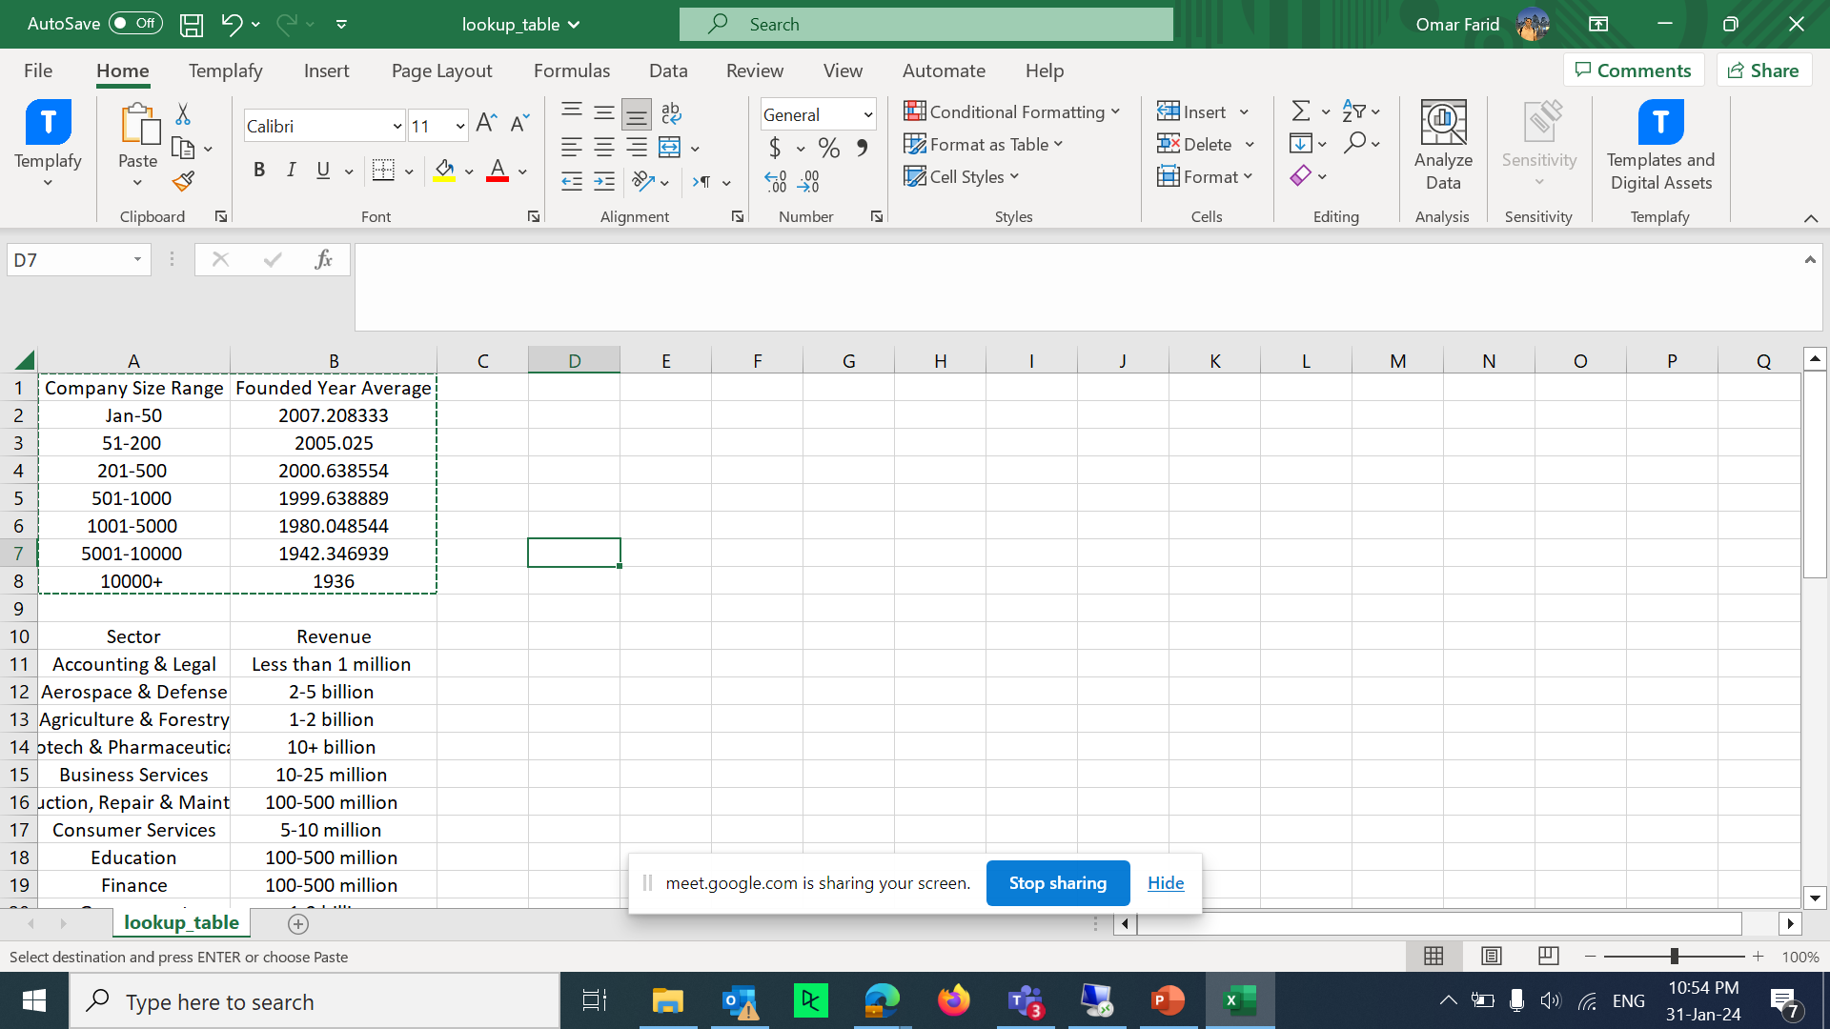
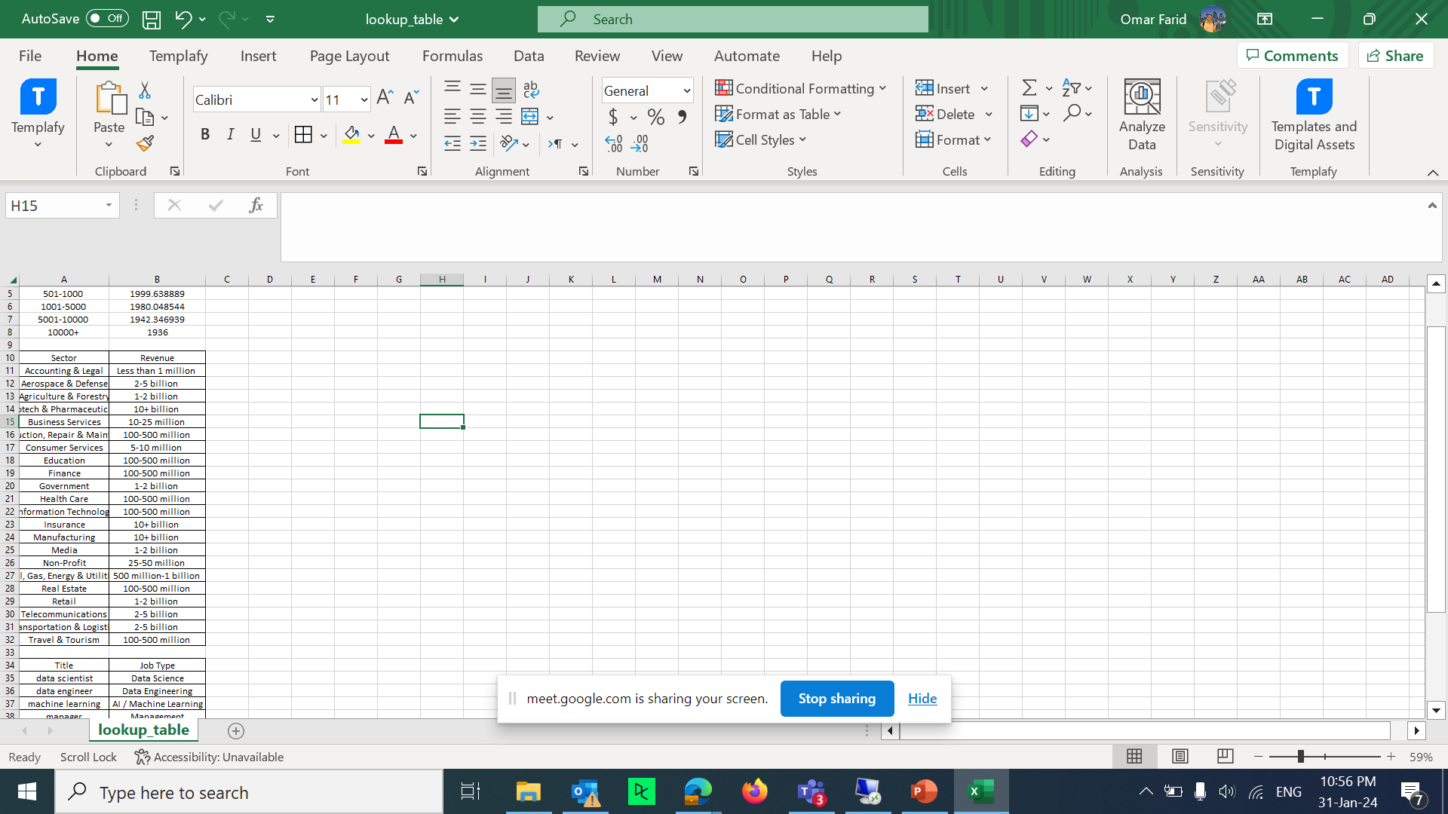
Feature Engineering
Mappings to create 2 new columns that include the Job Type and the level of the required Candidate

Slide 13

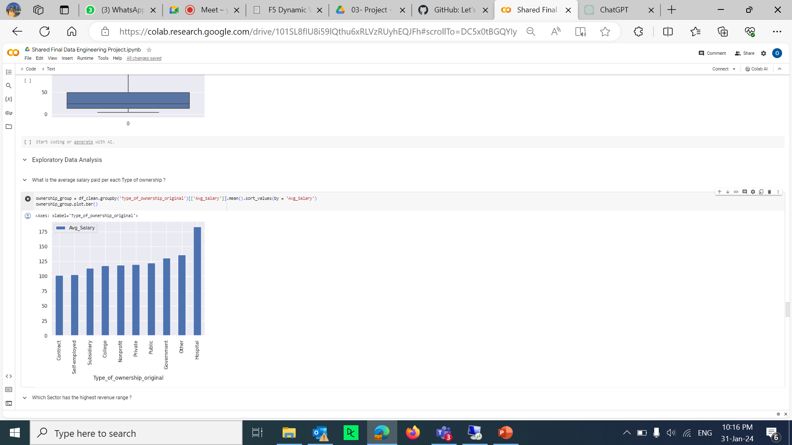
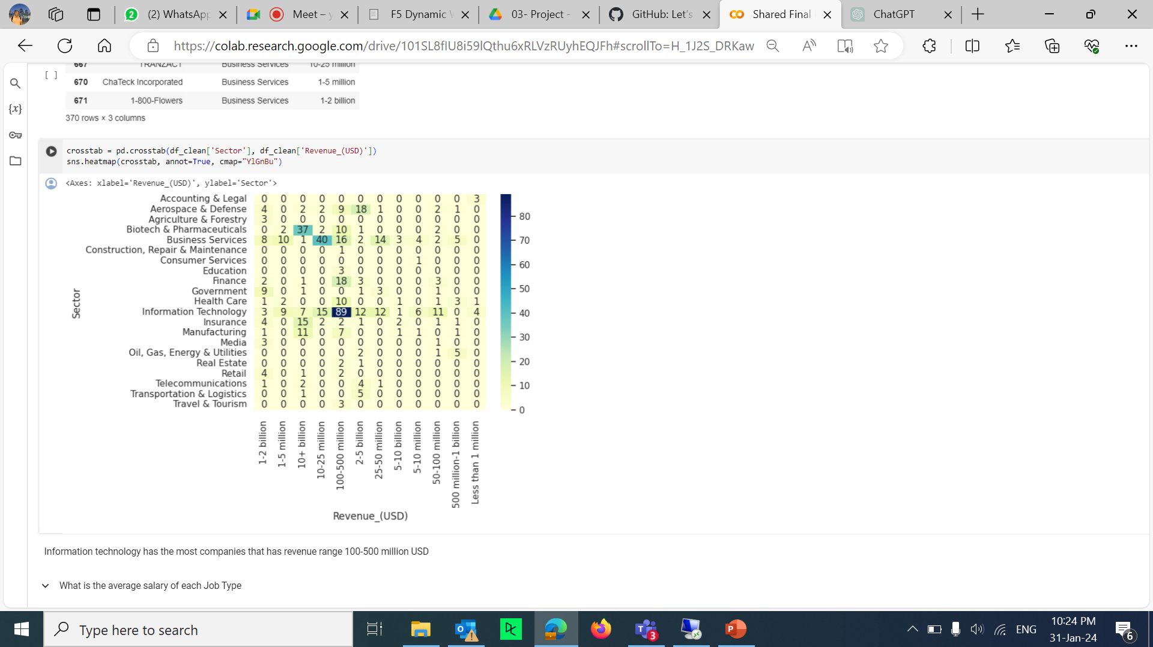
Exploratory Data Analysis
Avg Salary per Ownership type
Information technology has the most companies that has revenue range 100-500 million USD

Slide 14
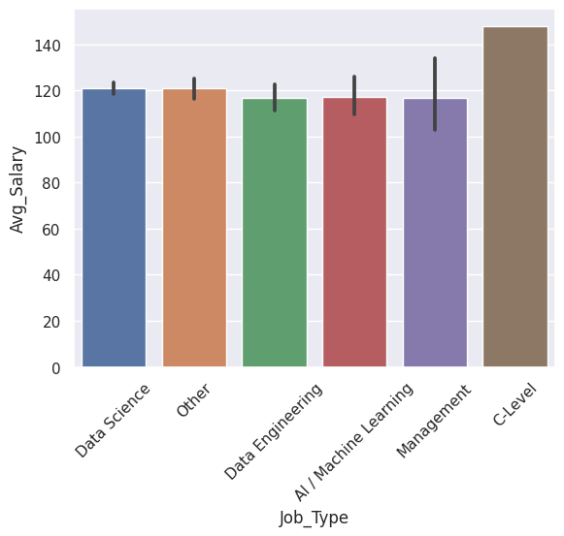
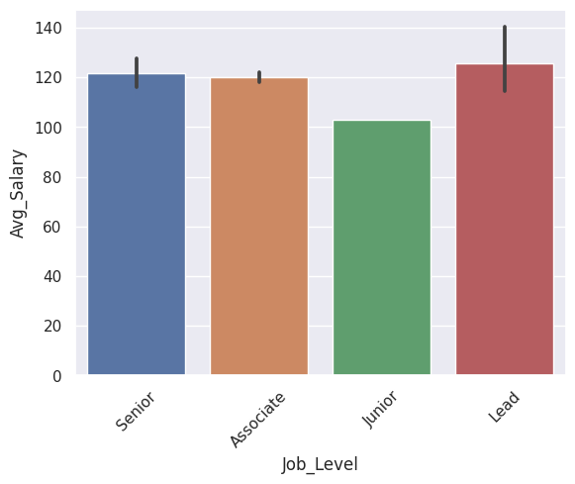
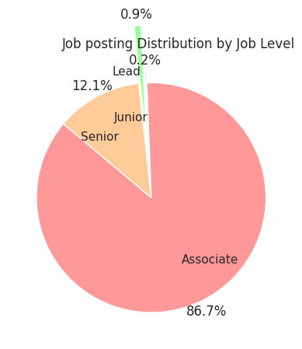
Exploratory Data Analysis
What is the average salary of each Job Type ?
What is the average salary of each job level ?
What is the Percentage of the job postings per Job level ?

Slide 15
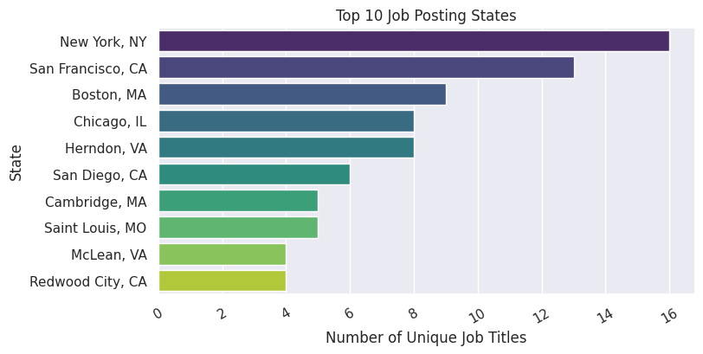
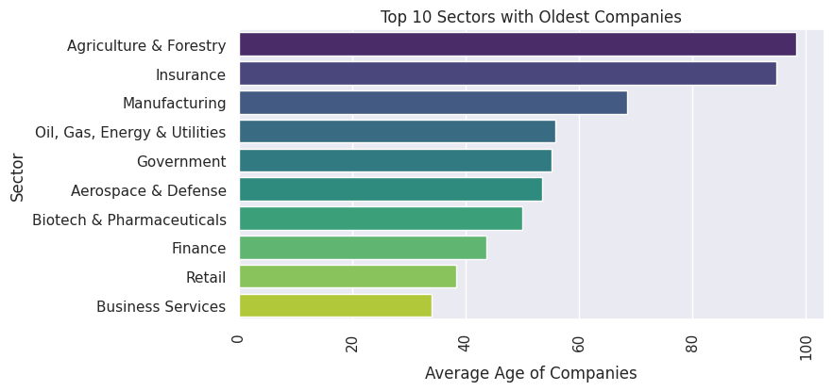
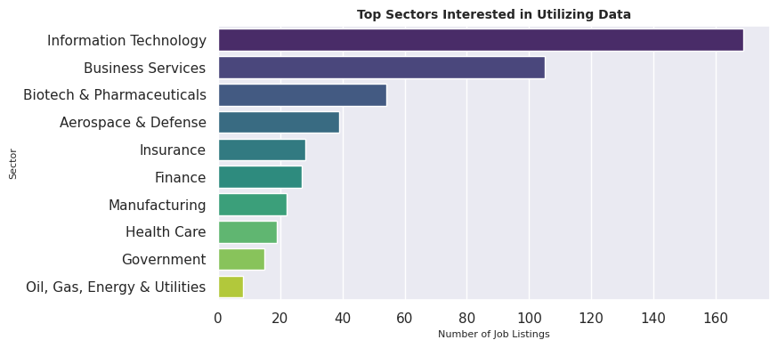
Exploratory Data Analysis

Slide 16


Airflow

Slide 17
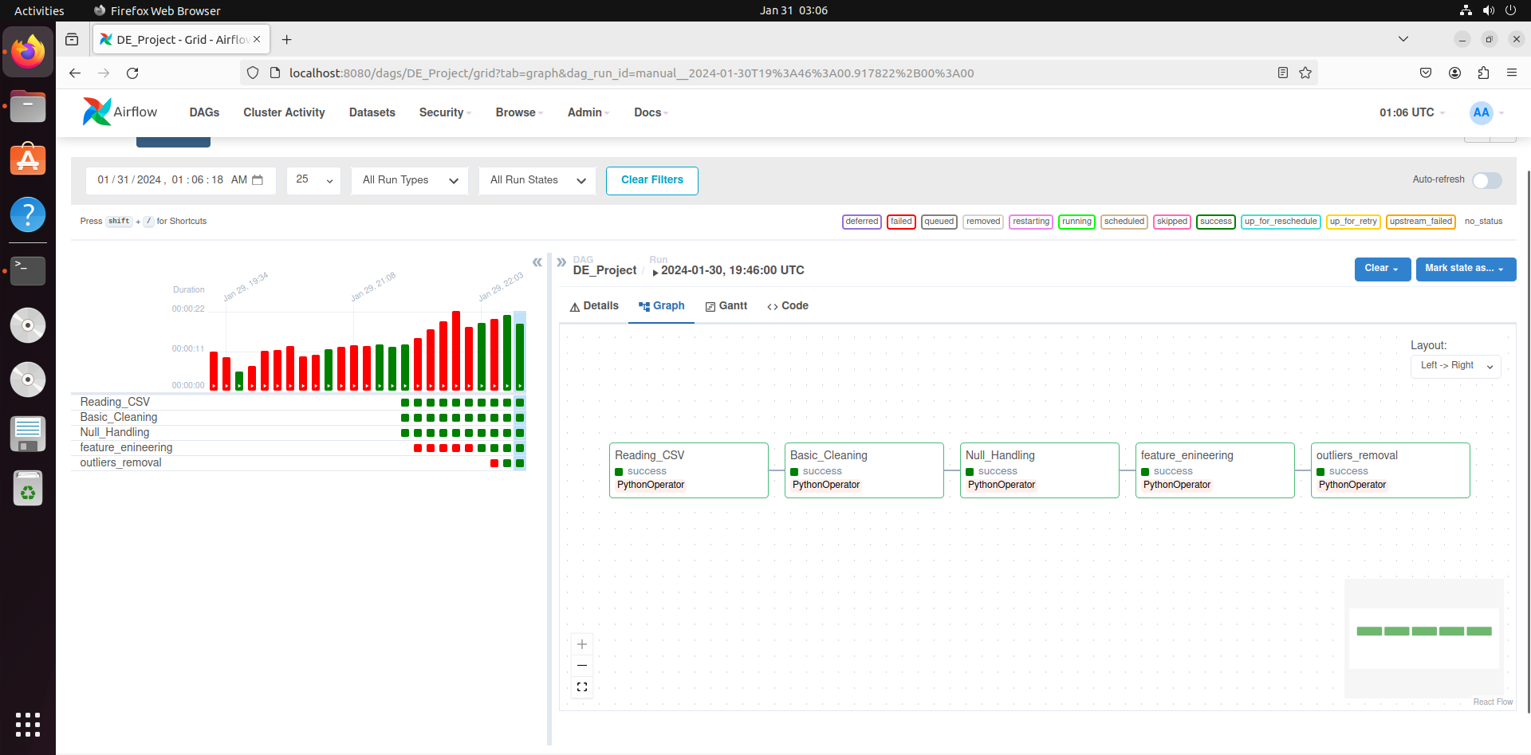
Airflow
Airflow, displaying a workflow's task execution with a bar chart on the left indicating task durations and status, and a Directed Acyclic Graph (DAG) on the right showing task dependencies and successful completions. We have divided
The workflow into four separate tasks. First transformation,
It performs basic cleaning values for each column. Second transformation, handling nulls (multivariate and univariate). Third transformation, Feature Engineering And last outliers removal.

Slide 18
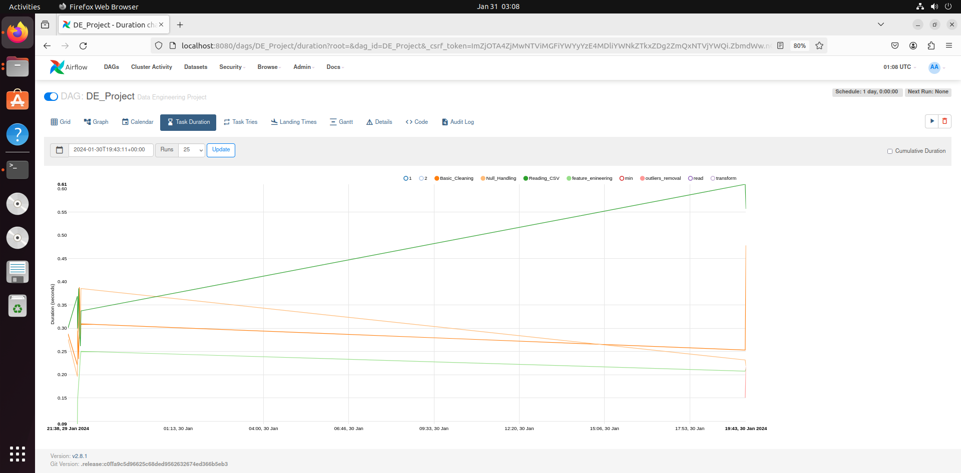
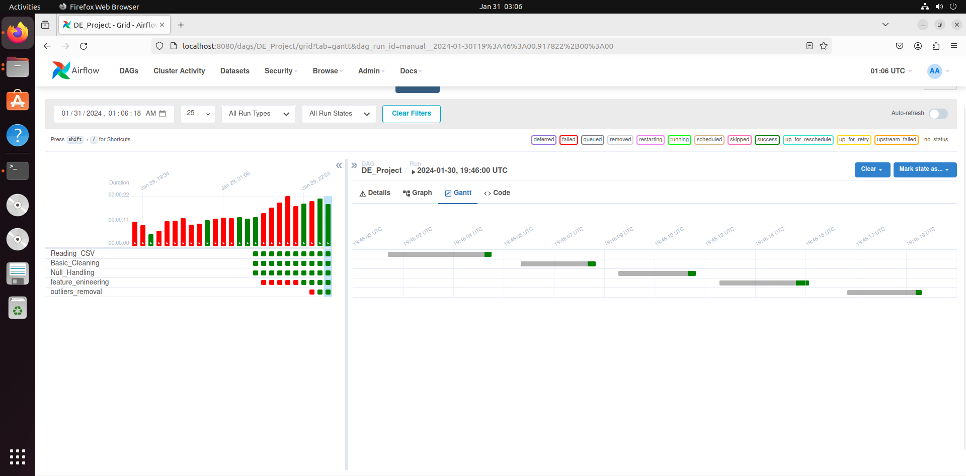
Airflow
x
Airflow Task Duration
Airflow Gantt Chart

